Slide 1

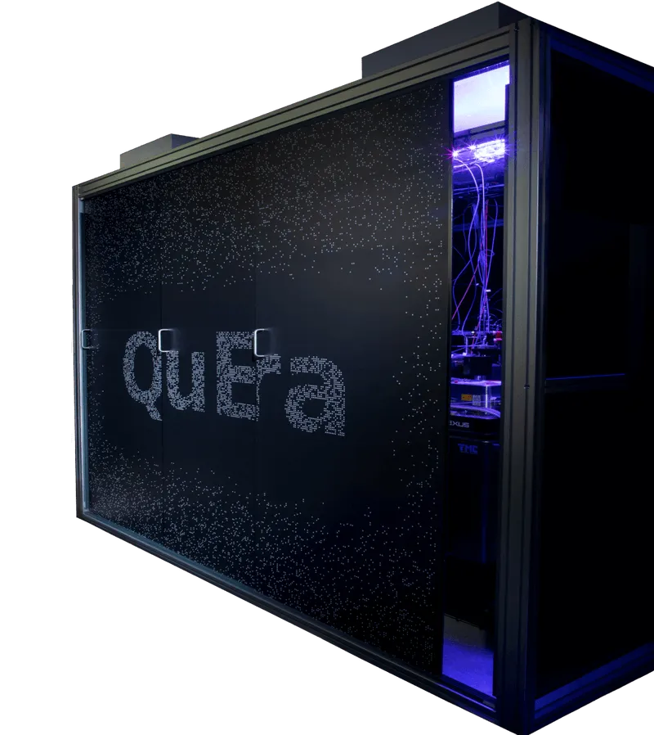
Many-body Quantum Scars
Zirui Zhan, Venkata Vikhyat Choppa, Yogesh Patil, Ethan Hu, Keith Cannon

Slide 2
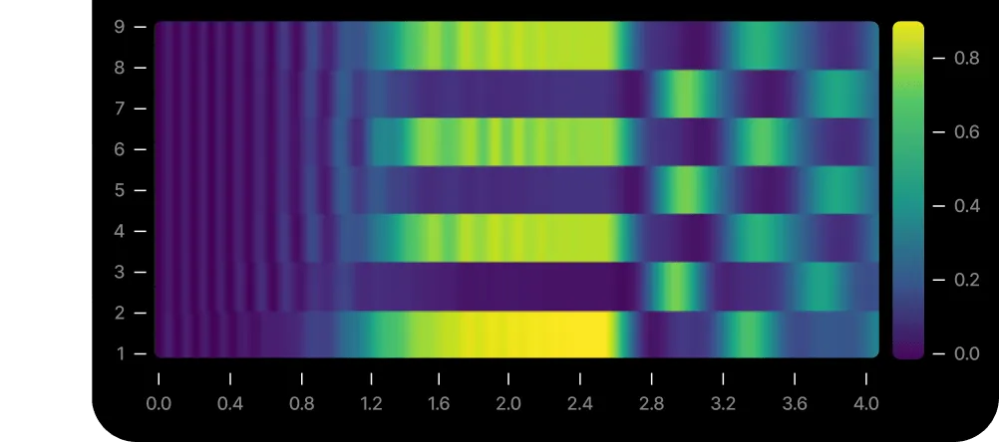
Table of contents
Parameter
Lattice Configuration
Parameter Optimization
Error Mitigation

Slide 3
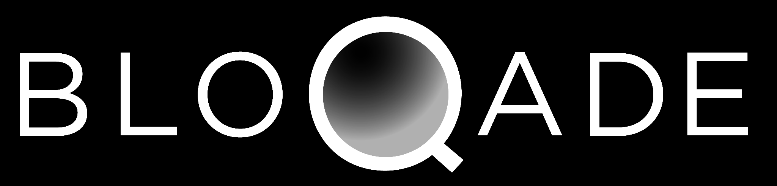
Parameter

Slide 4
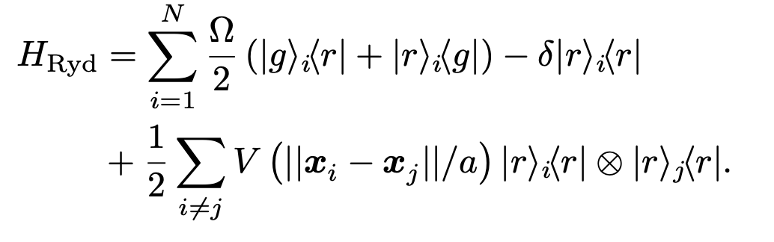
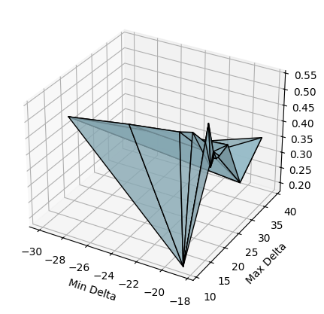
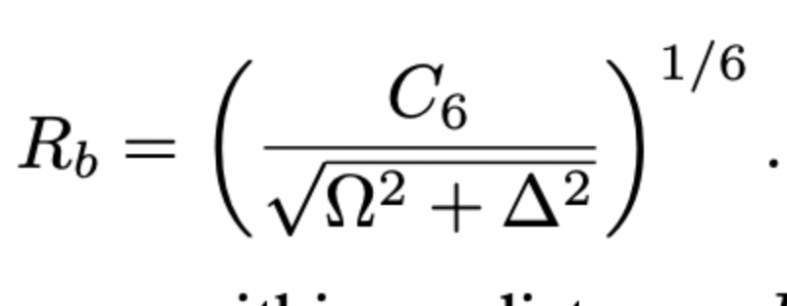
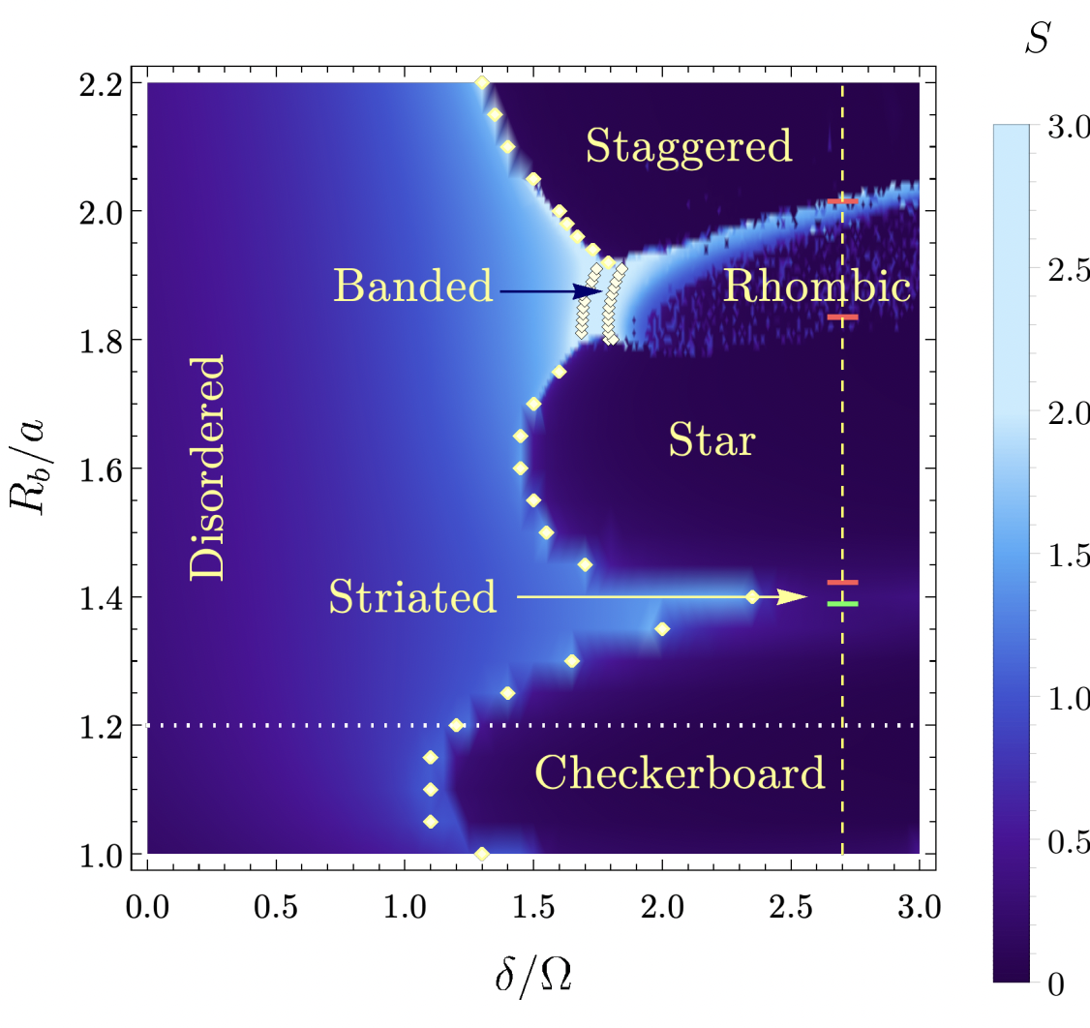
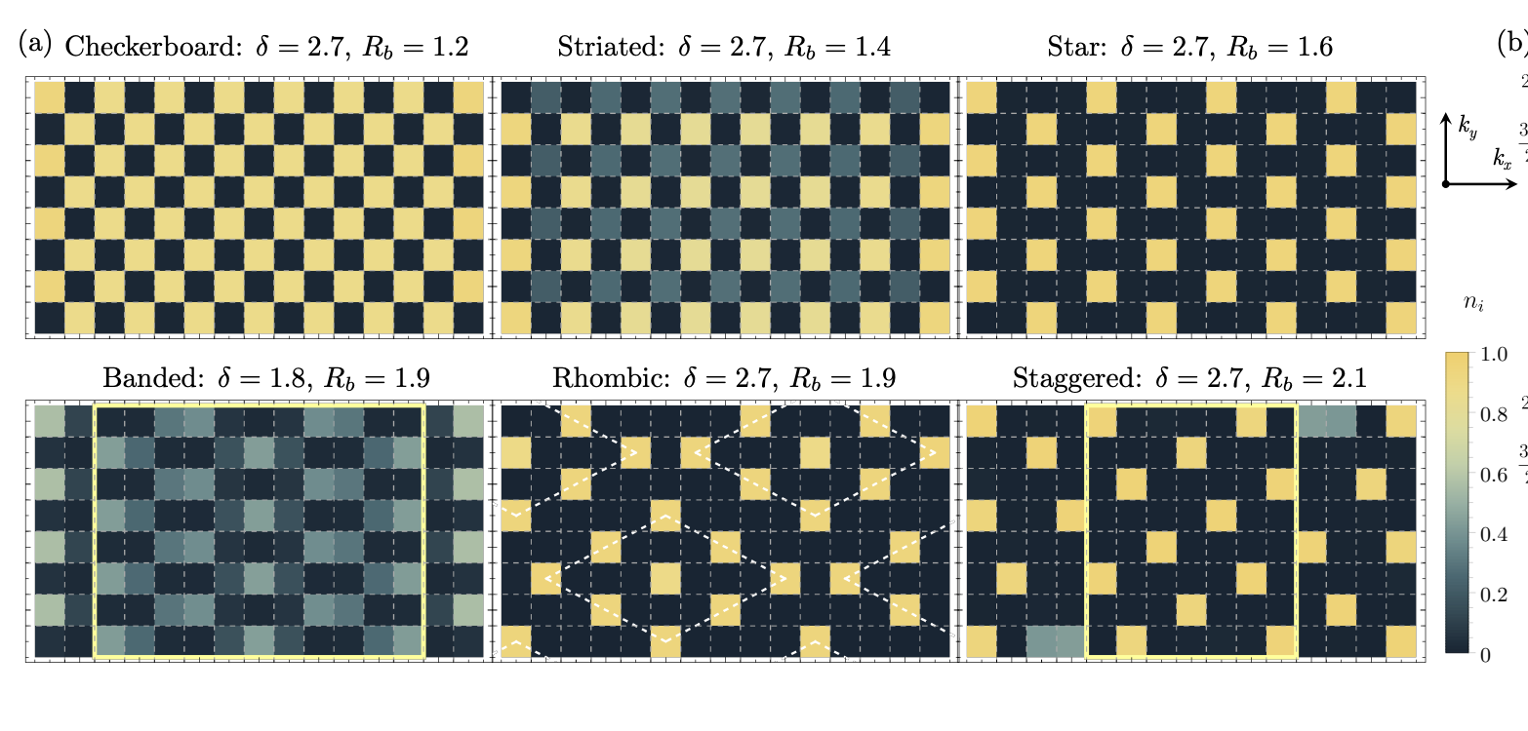
Parameter Configuration
n_atoms = 11
lattice_spacing = 6.1
run_time = var("run_time")
quantum_scar_program = (
Chain(n_atoms, lattice_spacing=lattice_spacing)
# define detuning waveform
.rydberg.detuning.uniform.piecewise_linear(
[0.3, 1.6, 0.3], [-18.8, -18.8, 16.3, 16.3]
)
.piecewise_linear([0.2, 1.6], [16.3, 0.0, 0.0])
# slice the detuning waveform
.slice(start=0, stop=run_time)
# define rabi waveform
.amplitude.uniform.piecewise_linear([0.3, 1.6, 0.3], [0.0, 15.7, 15.7, 0.0])
.piecewise_linear([0.2, 1.4, 0.2], [0, 15.7, 15.7, 0])
# slice waveform, add padding for the linear segment
.slice(start=0, stop=run_time - 0.065)
# record the value of the waveform at the end of the slice to "rabi_value"
.record("rabi_value")
# append segment to waveform that fixes the value of the waveform to 0
# at the end of the waveform
.linear("rabi_value", 0, 0.065)
)
# get run times via the following:
prep_times = np.arange(0.2, 2.2, 0.2)
scar_times = np.arange(2.2, 4.01, 0.01)
run_times = np.unique(np.hstack((prep_times, scar_times)))
batch = quantum_scar_program.batch_assign(run_time=run_times)

Slide 5
Lattice

Slide 6
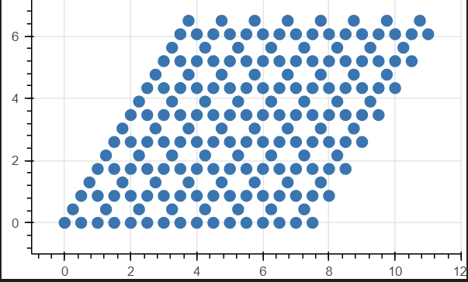
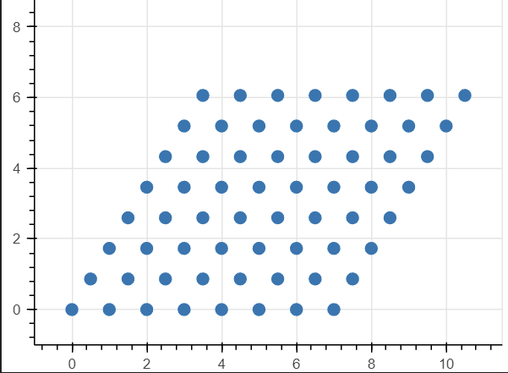
Issues

Slide 7
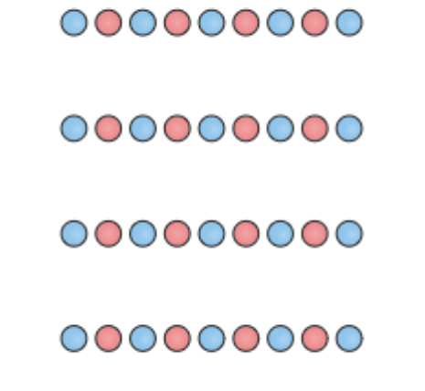
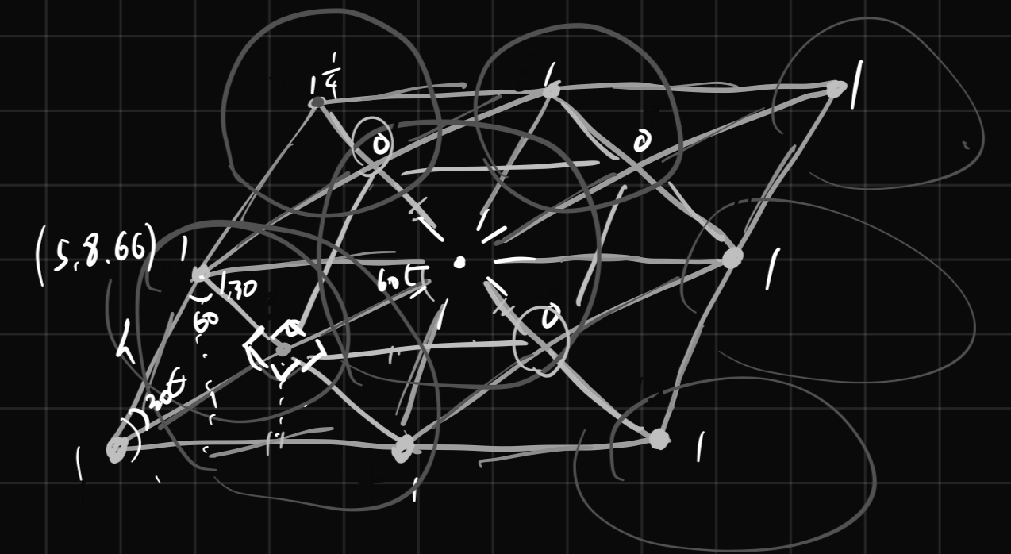
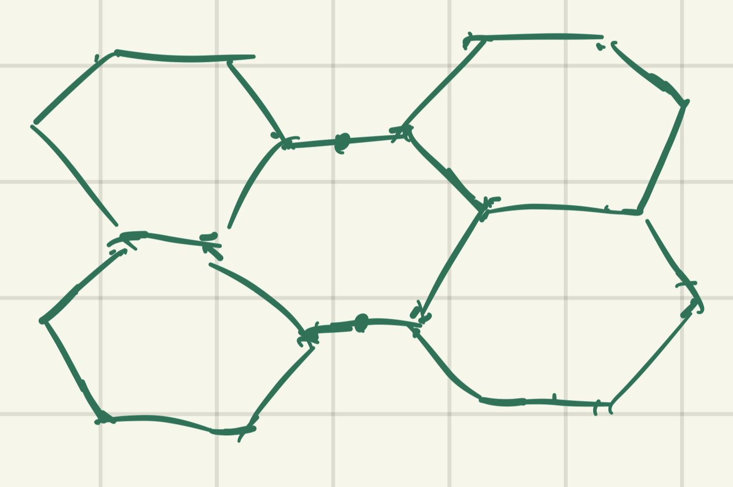
Chain
Parallelogram
Decorated Hexagon

Slide 8
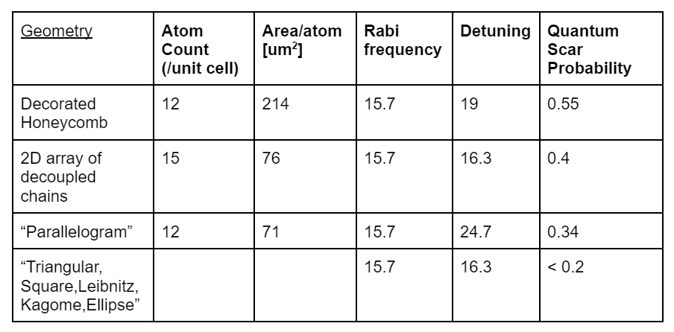
Lattice Analysis

Slide 9
Optimization

Slide 10
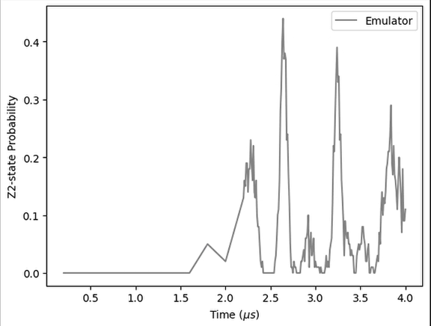
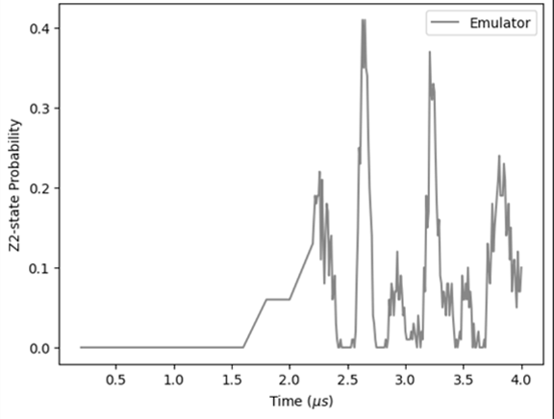
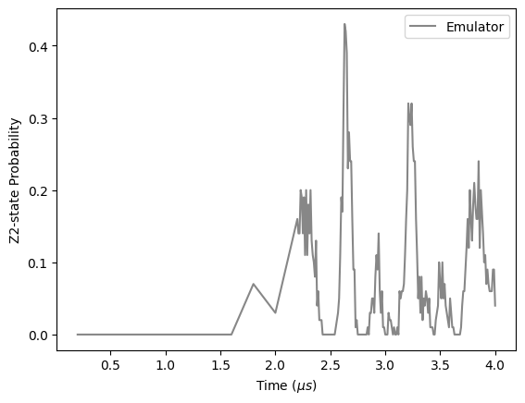
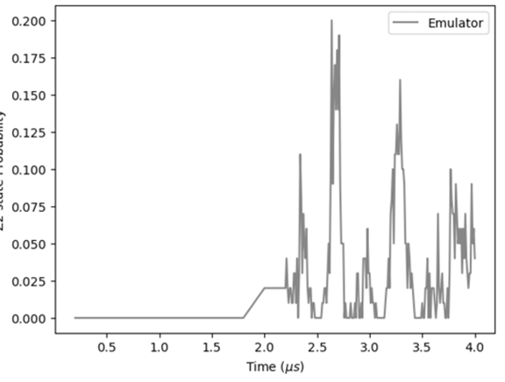
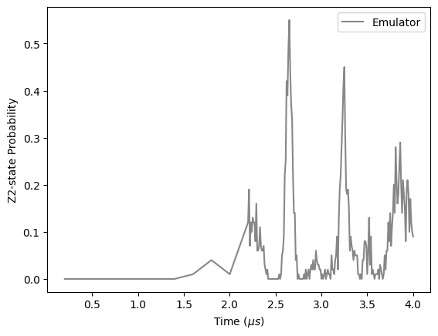
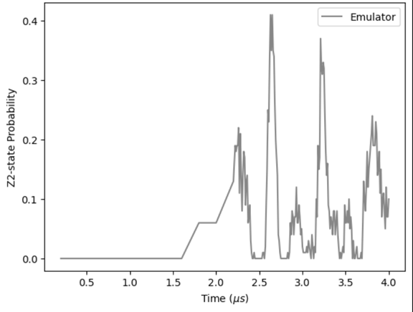
Linear Sweep

Slide 11
Error Mitigation

Slide 12
1. Obtain Original Distribution
2. Create Artificial Error
Original distribution is taken from a random sample within the quantum scaring, used as the optimal sample distribution
Artificial error is added to simulate noise on real quantum hardware with the given parameter
The Steps
3. Find Inverse Confusion Matrix
4. Apply REM
Confusion matrix is calculated for the bit string with the given noise bias
Inverse connfuse matrix is applied to the artificial error distribution in an attempt to less error towards original distribution

Slide 13
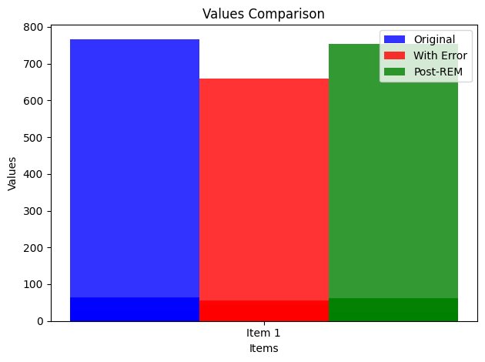
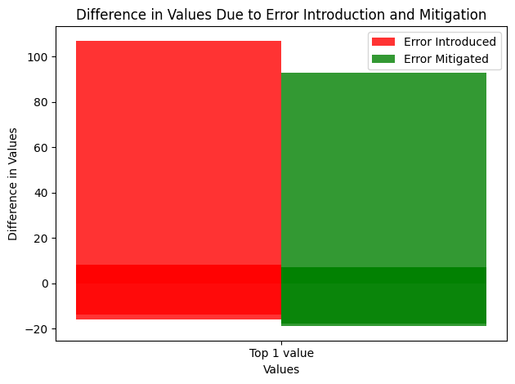
REM Results
Comparing the result of the before and after with the artificial error, REM successfully reverted the effects of the artificial noise.
Difference in distribution demonstrates the majority of the error being removed from the distribution samples

Slide 14
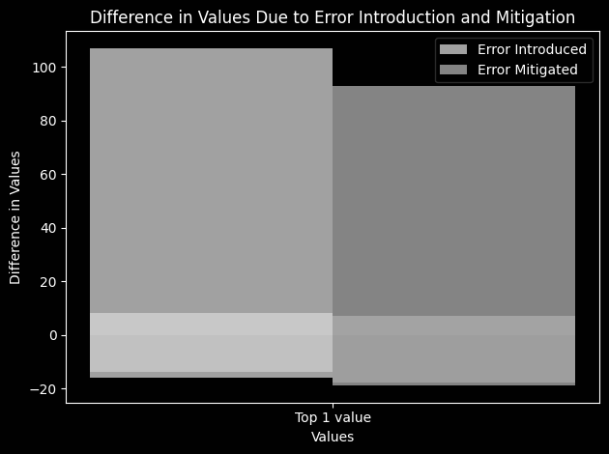
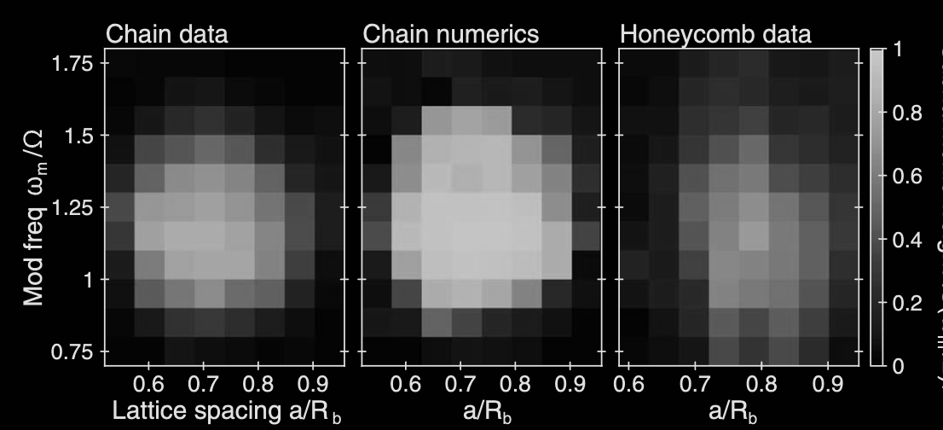
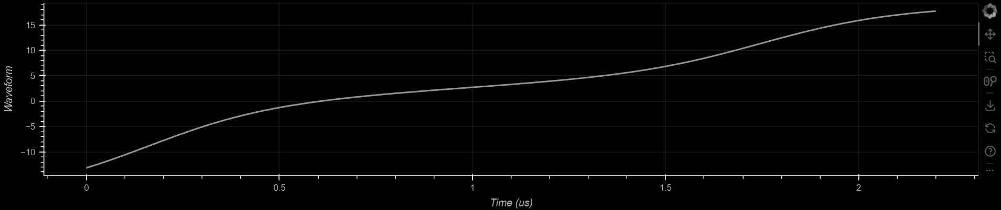
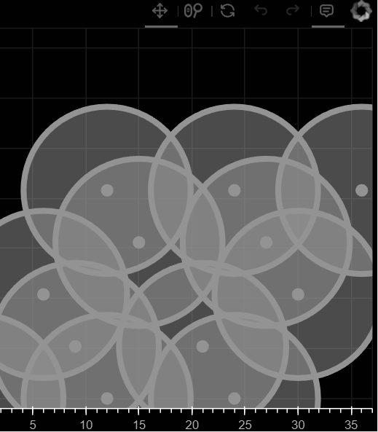
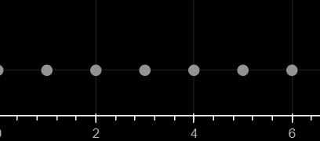
Thank You!

